Slide 1
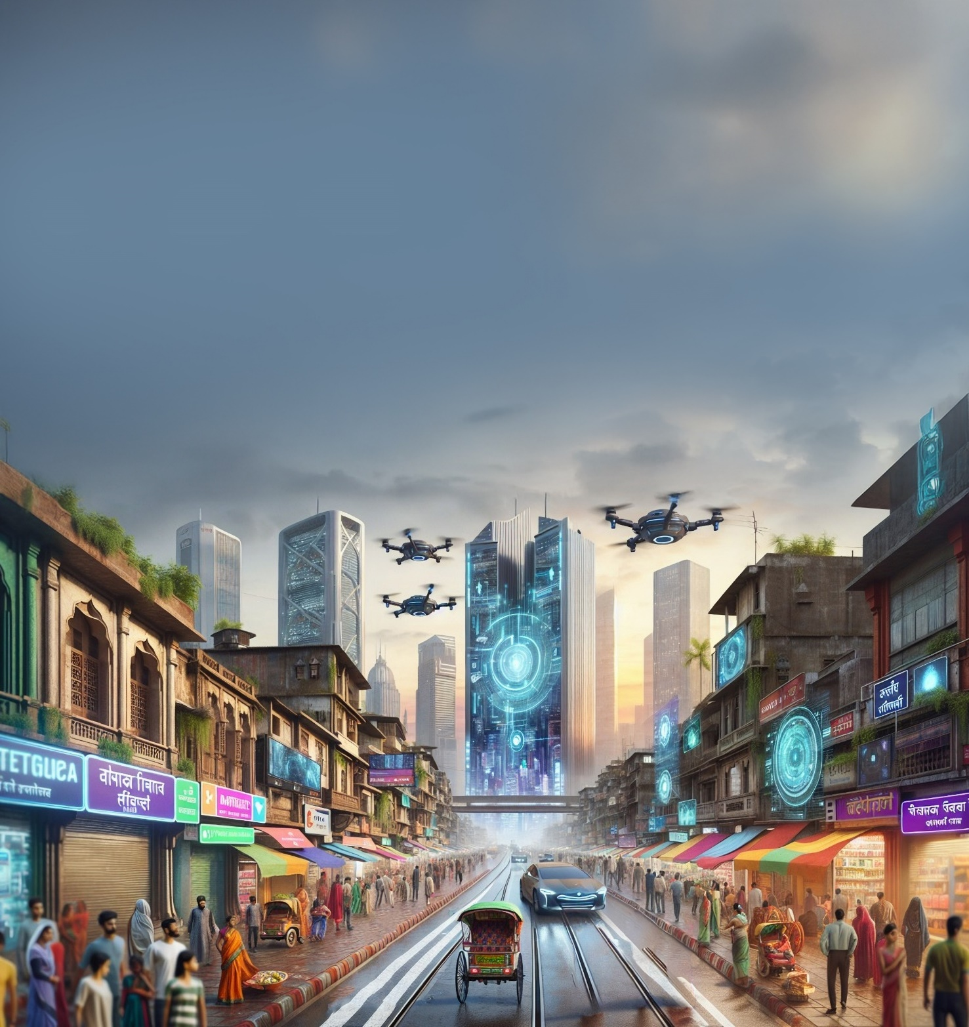





TEAM DETAILS:
Team Name: BREAKERS
Problem Statement : Challenge V: Retail [ABFRL]
Name: CHANDHURU M
COLLEGE: CHENNAI INSTITUTE OF TECHNOLOGY
DEPARTMENT: CSE
PHONE NUMBER:9677378758
Role in Solution Development:
Name: Hazeera B
COLLEGE: CHENNAI INSTITUTE OF TECHNOLOGY
DEPARTMENT: CSE
PHONE NUMBER:9344390080
Role in Solution Development:
Name: Soundharya M
COLLEGE: CHENNAI INSTITUTE OF TECHNOLOGY
DEPARTMENT: CSE
PHONE NUMBER:9342823658
Role in Solution Development:
Name: Sandhiya Sri R
COLLEGE: CHENNAI INSTITUTE OF TECHNOLOGY
DEPARTMENT: CSE
PHONE NUMBER:8825552885
Role in Solution Development:
Name: Chandiresh M G
COLLEGE: CHENNAI INSTITUTE OF TECHNOLOGY
DEPARTMENT: CSE
PHONE NUMBER:9363621956
Role in Solution Developmen:
Inventory sync
Integration of Agents
Barcode scanning
Merchant dashboards
Support dashboards
Payment methods
Loyalty & offers
Voice assistant
(3 languages)
Checkout flows
Telegram Integration
Module integration
User & merchant flows
Scalability planning
POS workflows
System design
Chatbot workflows
Product Intent detection
Payment methods
Recommendations
UI/UX design
Dashboard layouts
Analytics insights
Demo & presentation

Slide 2

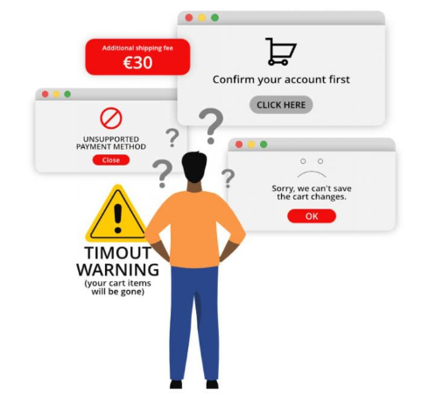



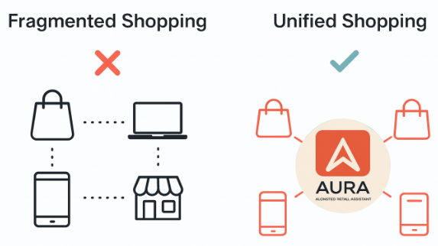
Executive Summary
Fragmented retail journeys and lack of personalized engagement — AI-powered Conversational Sales Agent to unify and personalize customer experience across all channels.
PROBLEM STATEMENT
Key Capabilities
• AI Conversational Assistant for guided shopping & recommendations • Barcode-based POS system for in-store billing • Unified inventory & cart management • Integrated payments and loyalty point synchronization • Merchant onboarding & admin approval dashboard • Analytics dashboard for sales insights and performance tracking
🟠 Customers experience fragmented shopping journeys across web, mobile apps, messaging platforms, and physical stores
🟠 Limited availability of sales staff results in missed upsell and cross-sell opportunities
🟠 Lack of real-time coordination between inventory, payments, promotions, and fulfillment systems
🟠 Absence of a personalized, human-like conversational experience reduces conversion rates and Average Order Value (AOV)
Reduced checkout friction | Loyalty synchronization
Unified customer journey | Omnichannel continuity
Improved personalization | AI-driven suggestions
Staff efficiency | Automated POS & inventory
Loyalty synchronization | Cross-channel rewards
IMPACT
VALUE
THE SOLUTION…
Disconnected omnichannel journeys reduce personalization and conversions
Target User
Customers: • Omnichannel shoppers seeking fast checkout • Preference-based recommendations
THE SOLUTION
Why This Solution Mattes?
Across retail platforms, the proposed system delivers an AI-powered conversational sales and POS solution that unifies online and in-store shopping.
It enables personalized recommendations, real-time inventory, barcode-based billing, and seamless checkout, ensuring consistent customer experiences across all channels.
🔸Eliminates fragmented customer journeys across channels 🔸 Enables real-time product discovery, checkout, and loyalty redemption 🔸 Reduces operational load on in-store staff through automation\
Result: Faster checkouts, consistent personalization, and higher customer satisfaction.
Merchants: • Inventory & POS automation • Sales analytics & customer insights
20–25%
improvement in conversions through reduced friction & personalization.

Slide 3
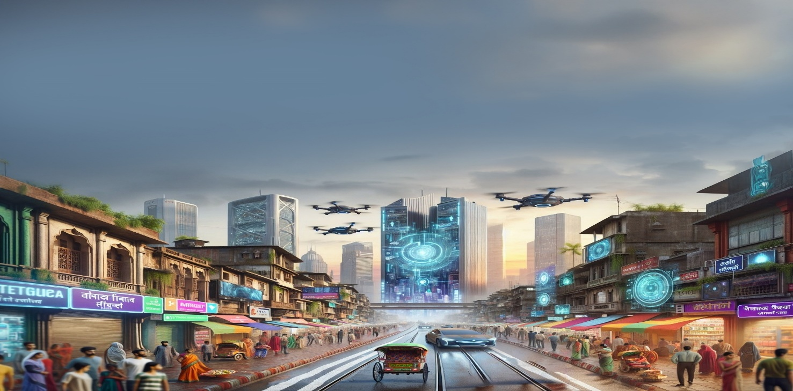
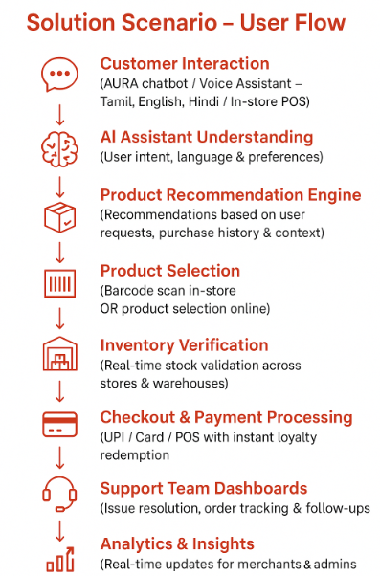

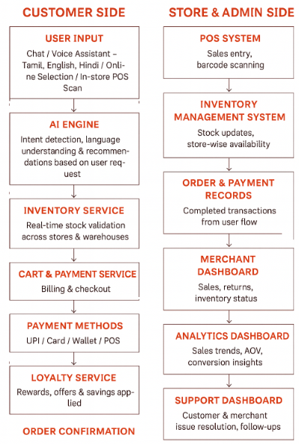
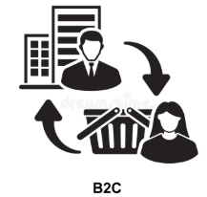

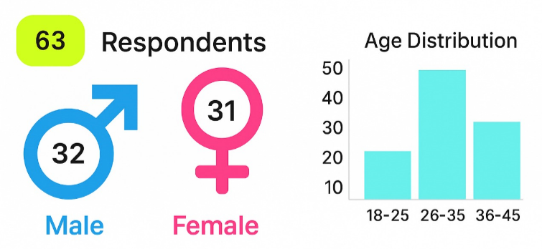
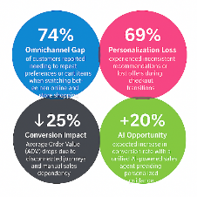
Understanding Of The Problem
Target Industry:
Retail & Fashion Commerce (Omnichannel Apparel Retail – Aditya Birla Fashion & Retail Ltd.)
Solution Scenario – User Flow
Proposed Data Flow
Industry Type:
B2C (Business to Consumer) Supporting in-store, online, assisted digital & voice-based shopping
Primary User Groups:
Customers – Online, in-store & voice-assisted shoppers
Store Staff – POS operators & sales associates
Merchants – Inventory & sales managers
Admins – Platform, analytics & operations team
Support Teams – Customer & merchant assistance teams
SURVEY RESULTS - LINK
User Departments
Nature of Output
Retail Operations
Sales & POS Management
Inventory & Supply Chain
Marketing & Loyalty Programs
IT, Analytics & Support Operations
🌐 Web Application – Chatbot, Admin & Support Dashboards 📱 Mobile-Responsive UI – Customer, Staff & Merchant access 🧾 In-store POS Interface – Barcode scan & billing
🎙️ Voice Assistant Interface – Tamil | English | Hindi
We conducted primary research only — an online survey of 100 customers to validate pain points in omnichannel shopping (preferences, checkout friction, and channel continuity)

Slide 4

Planned solution design
Solution Value Proposition to Target Users
Assumptions, Constraints & Decision Points
Response:
Assumes availability of product, inventory, and loyalty APIs (real or mocked)
Uses synthetic customer profiles and simulated POS for demo
Chose Gemini for multilingual conversational intelligence
Modular agent design ensures easy upgrades and minimal dependency coupling
Response:
AURA delivers a unified, AI-driven omnichannel shopping experience that seamlessly connects online, mobile, messaging, voice, and in-store interactions. It eliminates fragmented customer journeys by offering personalized, human-like conversations, real-time product recommendations, instant inventory validation, multilingual voice support (Tamil, English, Hindi), and automated checkout with loyalty redemption - improving customer satisfaction, conversion rates, and operational efficiency for retail staff and merchants.
Ease of Implementation & Effectiveness
Response: The solution is highly implementable using modular microservices and API-driven architecture. It can be incrementally deployed—starting with chatbot and POS integration—and scaled across channels. Effectiveness is high due to automation, personalization, and real-time orchestration of sales workflows.
Impact Metrics
Response:
Increase in Conversion Rate (%)
Growth in Average Order Value (AOV)
Reduction in Cart Abandonment Rate
Increase in Loyalty Redemption & Repeat Purchases
Reduction in In-store Staff Handling Time
Improvement in Customer Satisfaction (CSAT)
Robustness, Security & Scalability
Response:
Secure API communication with role-based access
Scalable cloud-ready architecture
Stateless AI agents for horizontal scaling
Easily extensible to add new worker agents (e.g., Gift-Wrap, Returns, Styling Advisor)
Technologies Involved
AI & LLM: Google Gemini (intent detection, multilingual NLP, recommendations) Frontend: React.js (React 18), Redux Toolkit, React Router, React Bootstrap, MDBReact Backend: Node.js, Express.js Voice Interface: Speech-to-Text & Text-to-Speech APIs Databases: MongoDB, Redis Payments: Stripe Payment Gateway
APIs: Google Gemini API, FakeStore API, Stripe API, Telegram Bot API, Gmail SMTP Real-Time Communication: Socket.IO (WebSockets) Authentication & Security: JWT, HTTP-only Cookies, bcrypt, CORS, Express Rate Limiting Storage & Media: Cloudinary Platforms: Web Application, Mobile-Responsive UI, In-store POS Interface
Solution Components to Build & Demonstrate (Next Round)
Response:
Multilingual AI Sales Agent (Chat + Voice)
Product Recommendation & Inventory Worker Agents
POS-integrated Checkout & Loyalty Flow
Merchant & Support Dashboards
End-to-end omnichannel demo showcasing channel switching and session continuity

Slide 5
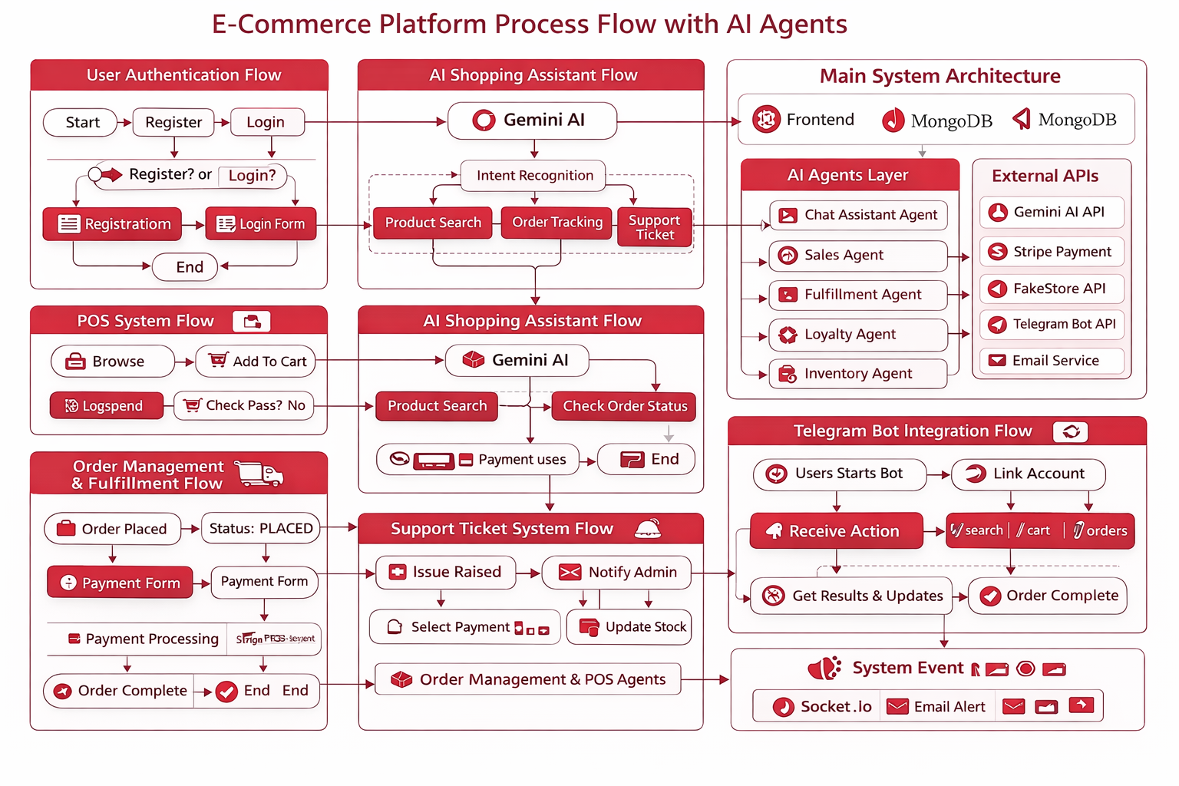
FLOWCHART
Summary Of Flowchart
Users interact with the system through a website, mobile app, or chat interface.
All user requests are handled by a central backend server that manages business operations.
AI services analyze customer messages to understand intent and provide smart recommendations.
Dedicated agents manage key functions such as orders, inventory, loyalty points, fulfillment, and post-purchase actions.
External systems like payment gateways, notification services, and third-party product APIs are securely integrated.
This modular architecture ensures scalability, reliability, and a smooth customer experience from browsing to after-sales support.

Slide 6
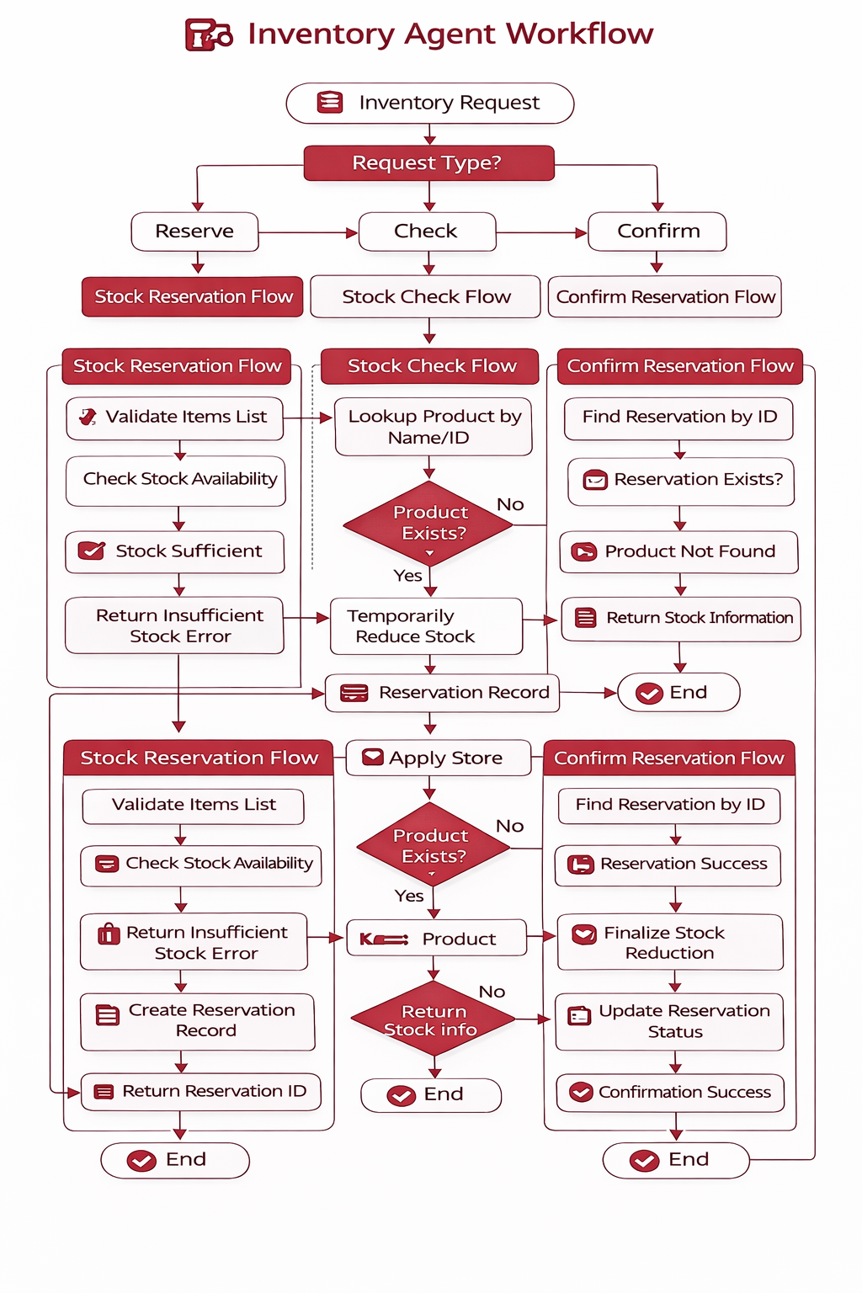
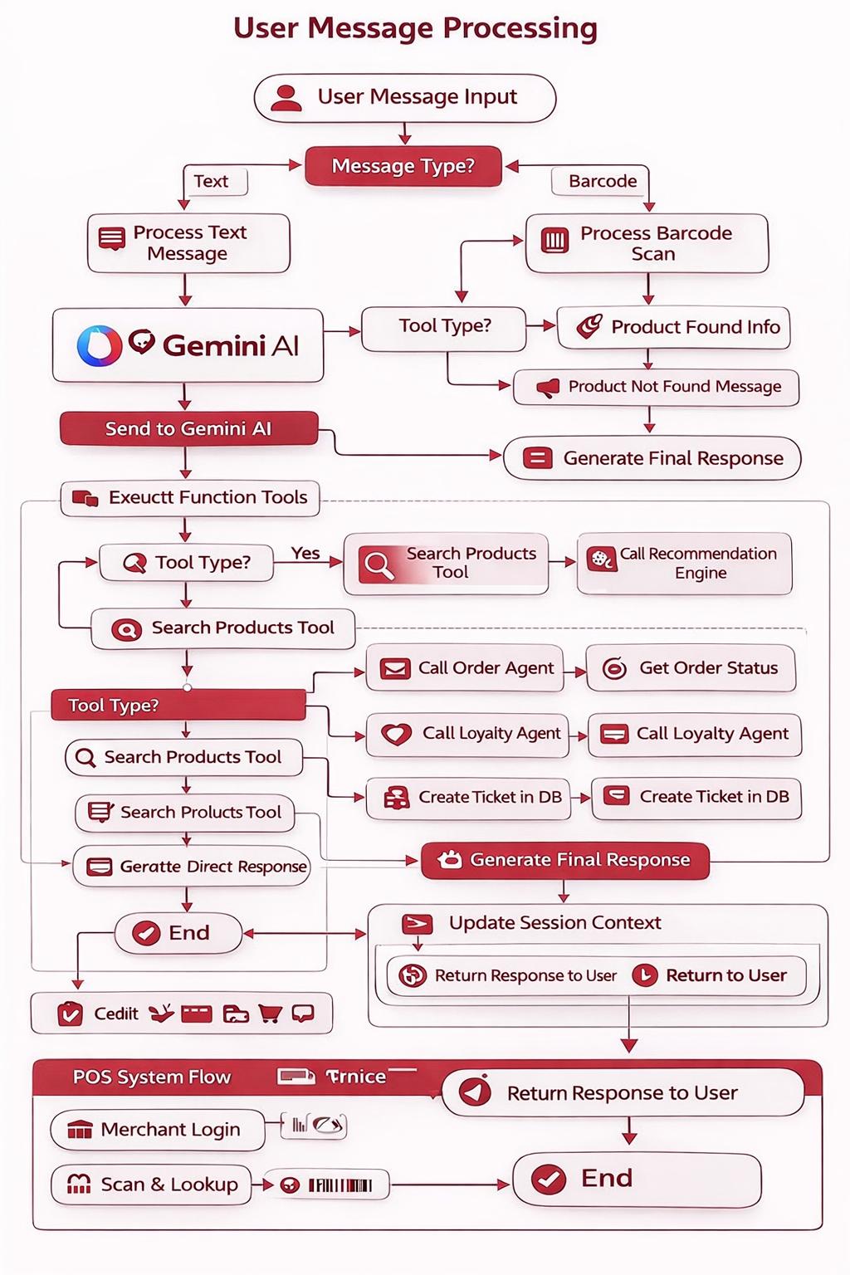
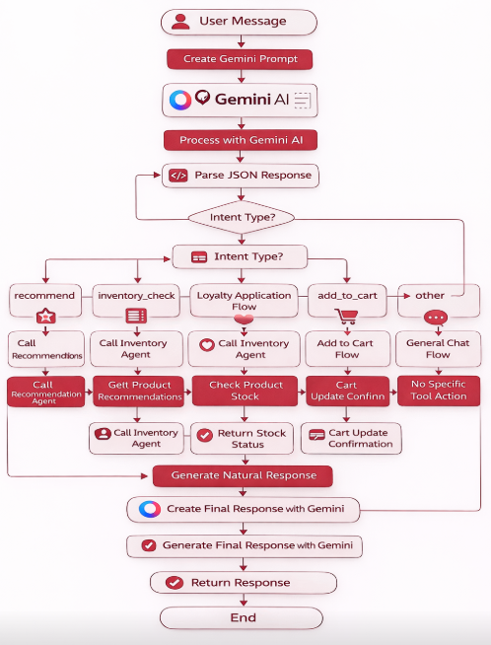
ARCHITECTURE
Chat Assistant Agent
Sales Agent
Inventory Agent
User searches for a product using keywords or a query.
Sales Agent processes the query by cleaning keywords and matching products.
Products are fetched from the database and external sources if needed.
Results are ranked and personalized based on user preferences or trends.
Top product recommendations are returned to the Chat Assistant for display.
User sends a message (question, search, order query, etc.).
Gemini AI understands the intent of the message.
Chat Assistant decides whether to answer directly or call a system agent.
Relevant agent works (products, orders, loyalty, support, cart).
Clear response is sent back to the user with updated session details.
Request is received to check, reserve, or confirm product stock.
System verifies product availability in the inventory.
Stock is temporarily reserved if items are available.
Reservation is confirmed or rejected based on order status.
Final stock status or error message is returned to the system.

Slide 7
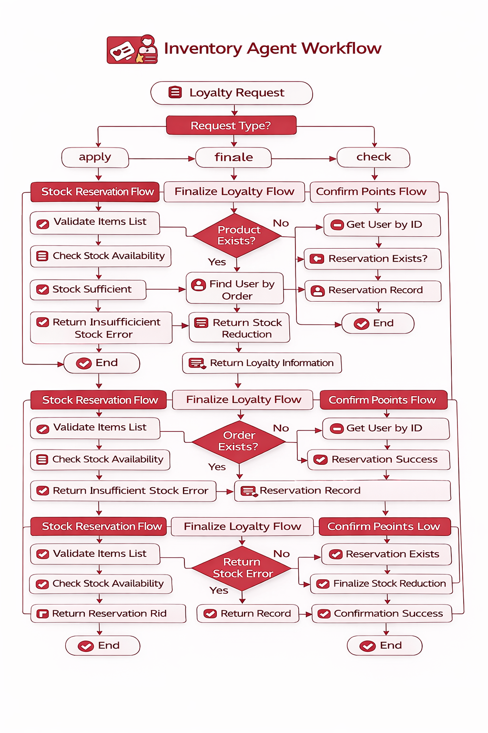
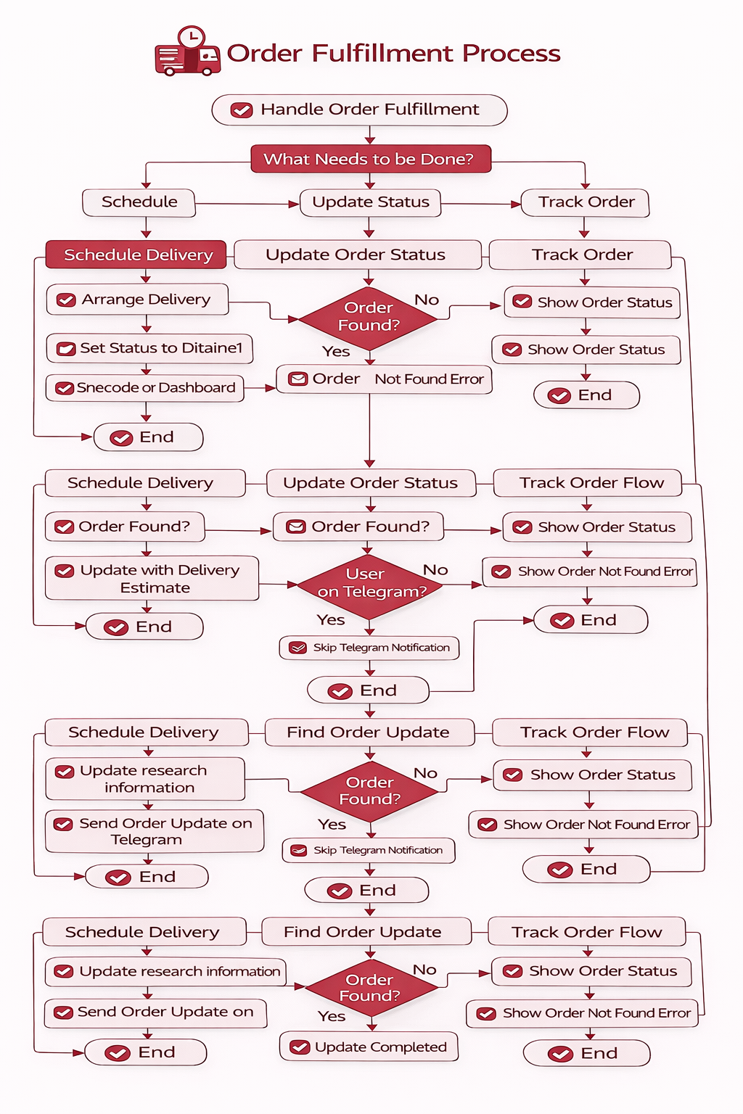
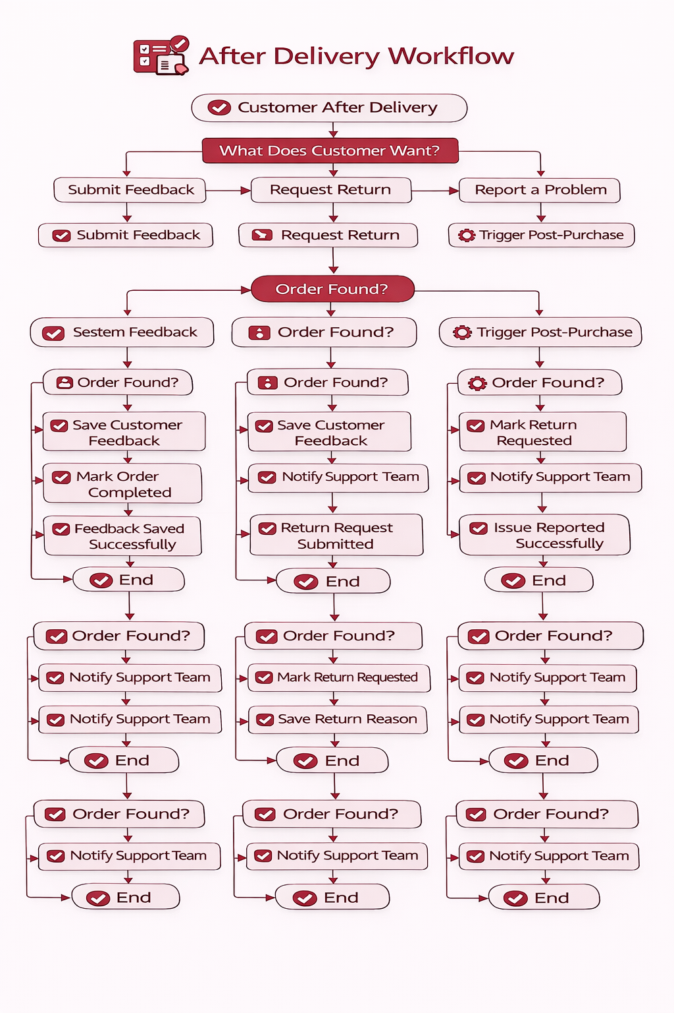
ARCHITECTURE
Loyalty Agent
Fulfillment Agent
Post-Purchase Agent
.
Loyalty request is received to check points, apply discounts, or finalize rewards.
User and order details are verified in the system.
Available points and discounts are calculated and shown.
Used points are deducted and new points are awarded after purchase.
Loyalty history is updated and confirmation is returned to the user.
Fulfillment request is received to schedule, update, or track an order.
Order details are verified in the system.
Delivery is scheduled or status is updated (Processing, Shipped, Delivered).
Customer is notified via Telegram or email about order status.
Tracking information or final confirmation is returned to the user.
Post-purchase request is received after order delivery.
Order is verified before any action is taken.
Customer action is processed (feedback, return, or issue report).
System updates order status and notifies the support team if needed.
Confirmation is sent back to the customer

Slide 8
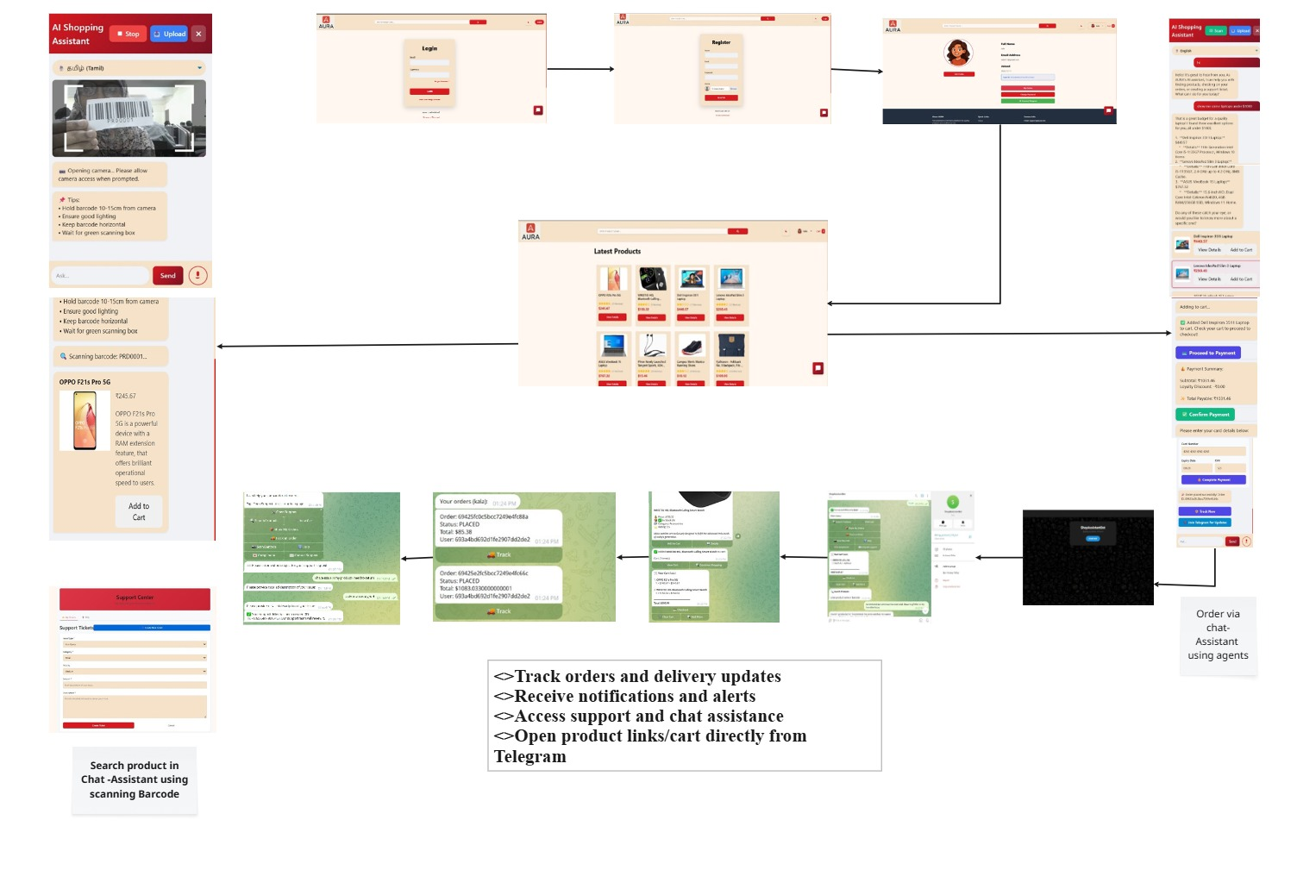
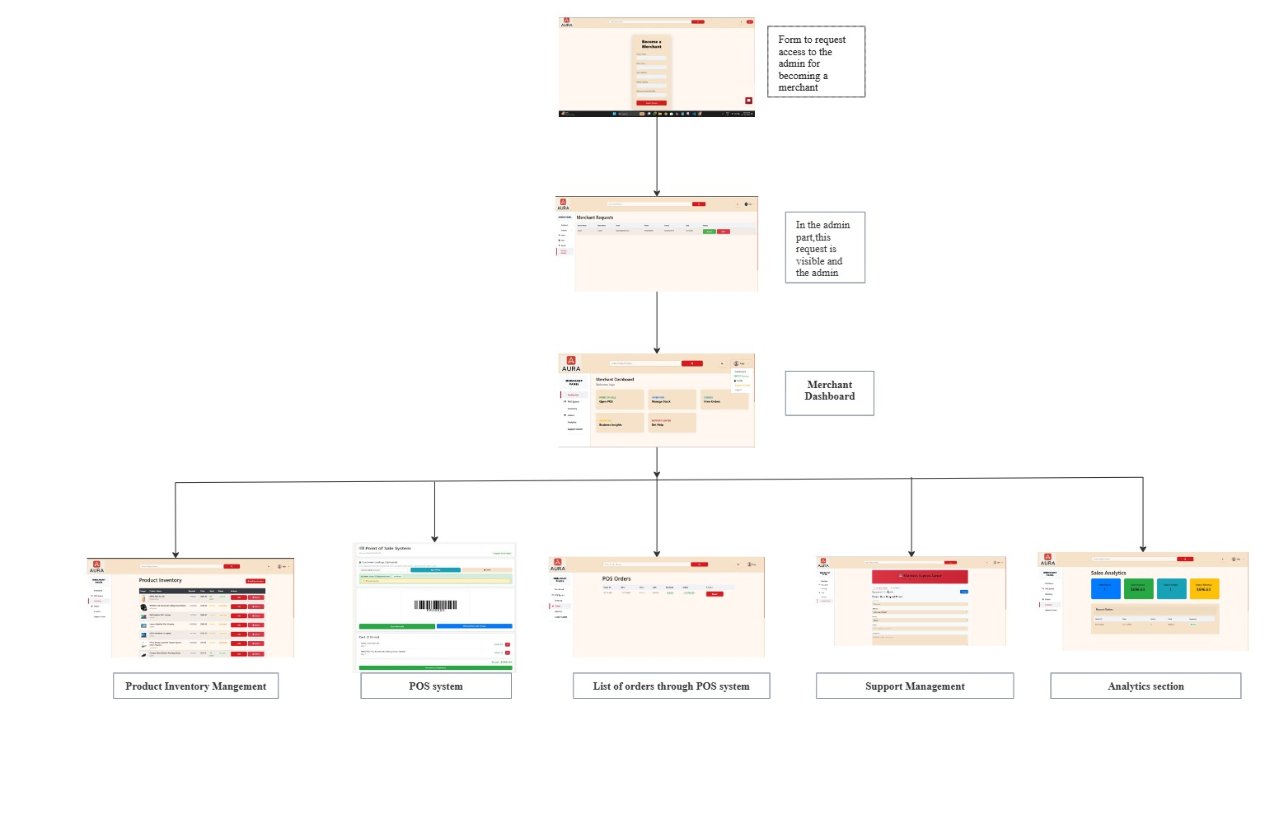
WIREFRAME OF WEBSITE
WIREFRAME-USER
WIREFRAME-MERCHANT SIDE
Loyalty Agent
AI Shopping Assistant
1.User Login User logs in to access the platform.
2.AI Shopping Assistant User opens the AI shopping assistant .Product Search (Barcode Scan)Product is searched using barcode scanning.
3.Product Details & Availability System displays product information and stock status. Add to Cart (Website)User selects the product and adds it to cart.
4.Checkout & Order Confirmation Order is placed securely via the website.
5.Telegram Post-Order Support Order tracking, notifications, and support via Telegram.
Instore shopping with AURA 1. Access Request Merchant requests admin access.
2.Admin Approval Admin reviews and approves request.
3.Merchant Dashboard Merchant gains dashboard access.
4.Inventory & POS Manage products and POS billing.
5.OrdersView and track POS orders.
6. Support & Analytics Handle support and view insights.

Slide 9
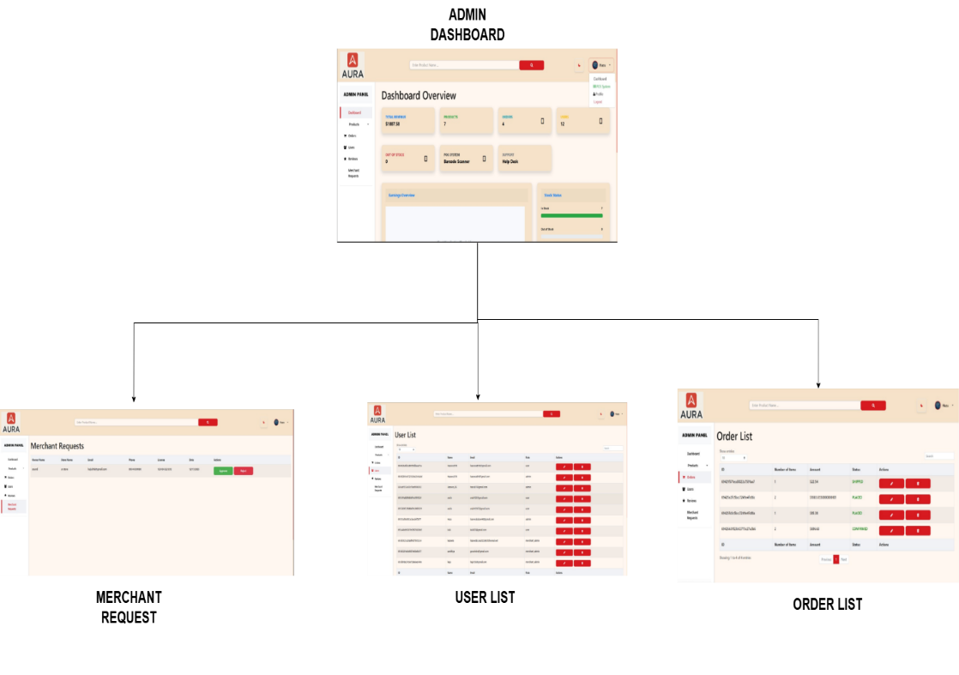
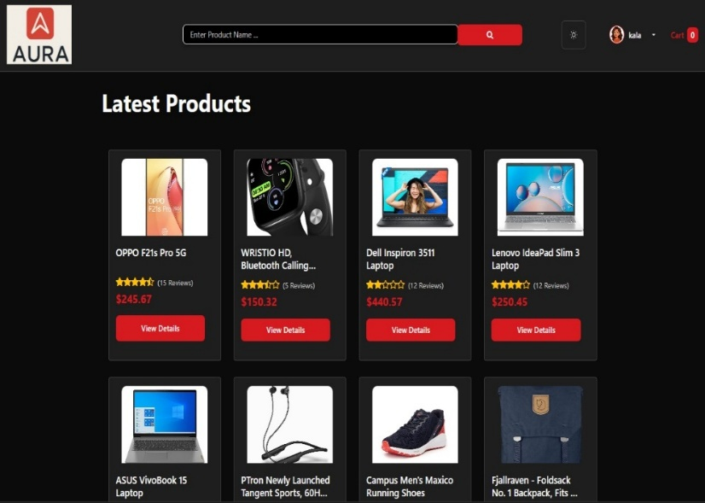
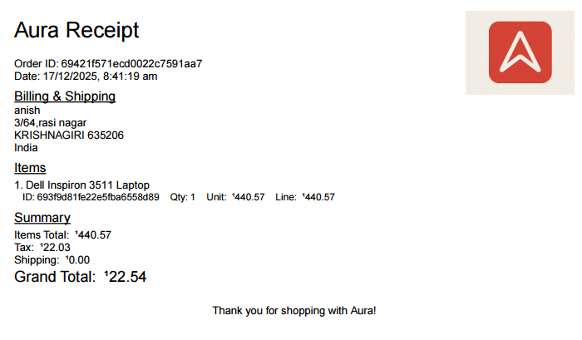
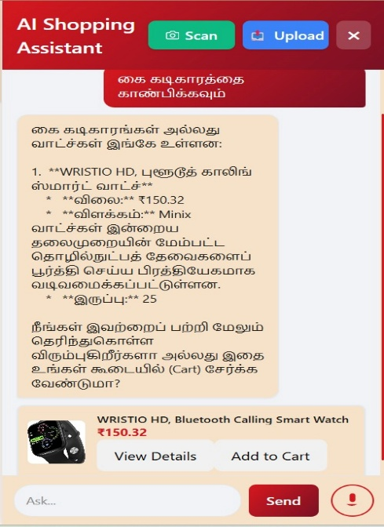
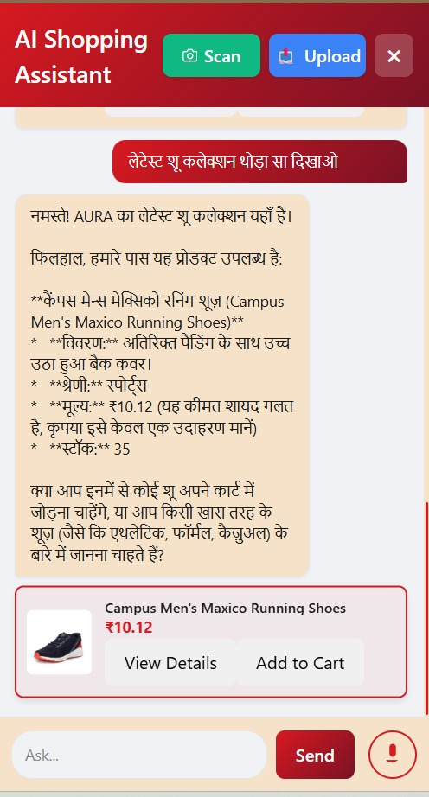
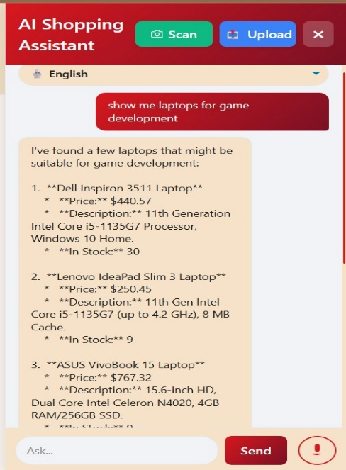
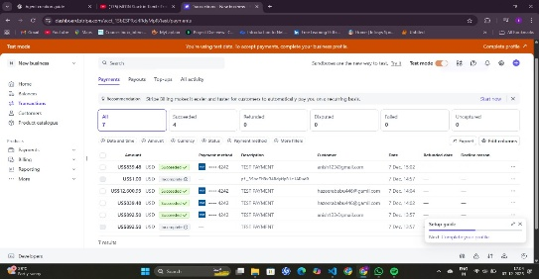
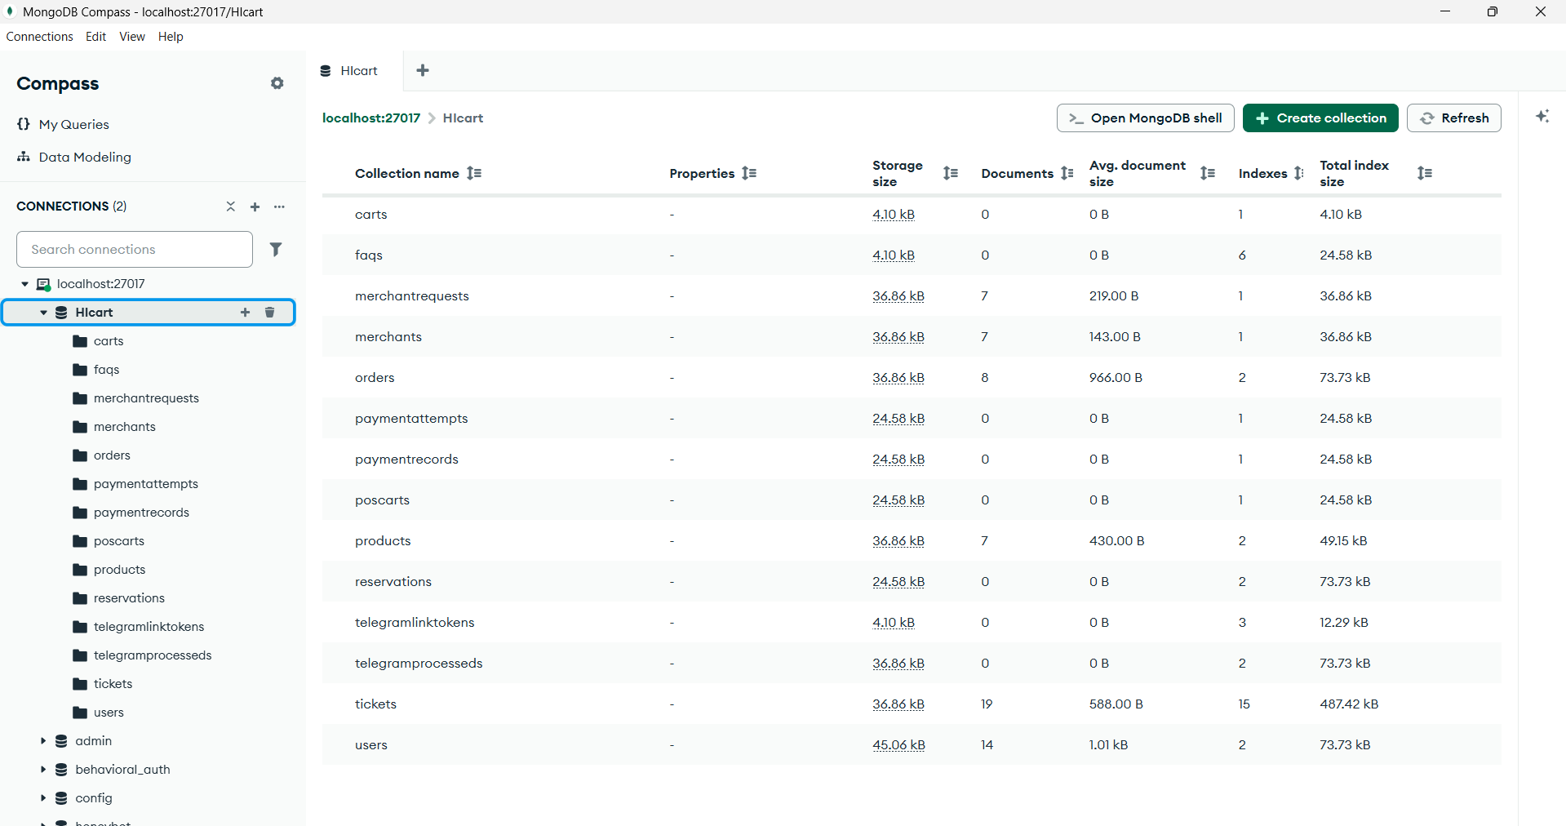
WIREFRAME-ADMIN
DARK THEME & RECEIPT GENERATION
CHATBOT FEATURE (Tamil,Hindi,English)
Dashboard System metrics and activity summary:
1.Merchant Requests Review and approve merchant access.
2.User Management View and manage platform users.
3.Order Management Monitor and control all orders.
STRIPE & DB SCHEMA

Slide 10
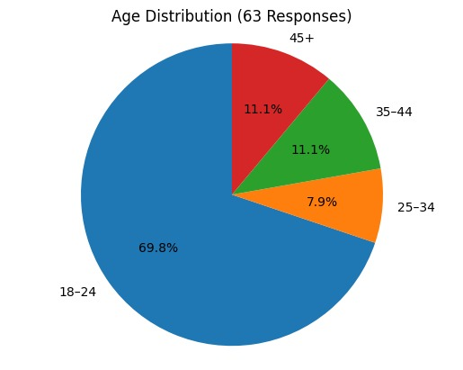
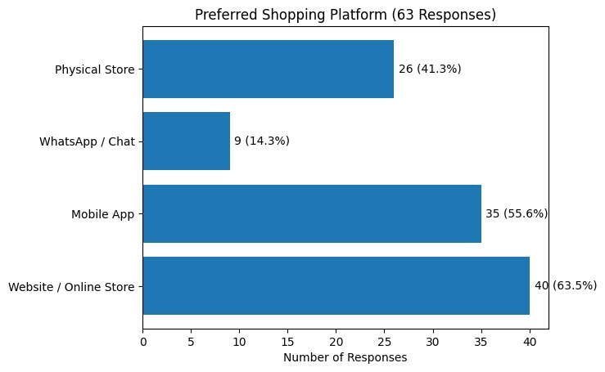
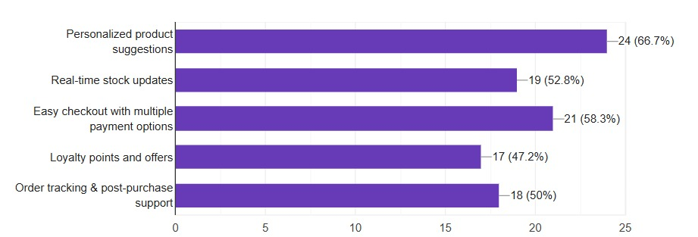
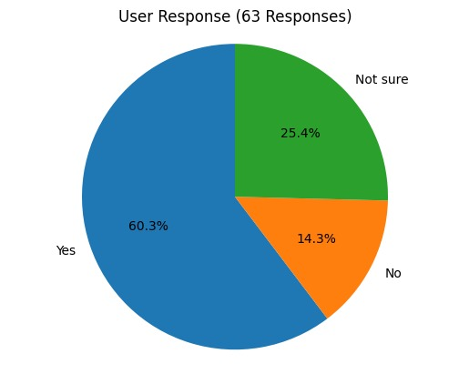
PROTOTYPE –LINKS FOR DEMO
CODE REPOSITORY
DEPOLYMENT LINK
GITHUB LINK- https://github.com/Chandhuru-M/E-COMMERCE.git
ZIP FILE: DOWNLOAD NOW
LINK -https://e-commerce-ten-xi-51.vercel.app/
SNAPSHOTS OF PROTOTYPE
RESEARCH FINDINGS
SCREENSHOT FOR DEMO
DRIVE LINK - CLICKNOW
FORM LINK – CLICK HERE
RESPONSE FROM USERS (without AI using e-commerce)
YOUTUBE LINK FOR DEMO
PROTOTYPE DEMO LINK
CLICKNOW
DEMO VIDEO
DEMO VIDEO LINK
CLICKNOW

